Slide 1


University Ca’ Foscari of Venice
Department of Environmental Sciences, Computer Science and Statistics
Master’s degree in Computer Science and Information Technology - Cybersecurity
Another SYN in the Wall:
Mitigating TCP Side-Channel Attacks via Randomized SYN-Queue Eviction
Advisor
Prof. Maccari Leonardo
Graduand
Finesso Davide
Student ID: 881825
Academic year
2024/25

Slide 2
The attack - Presentazione problema
dettaglio kernel utilizzato obiettivo
Finesso Davide

Slide 3

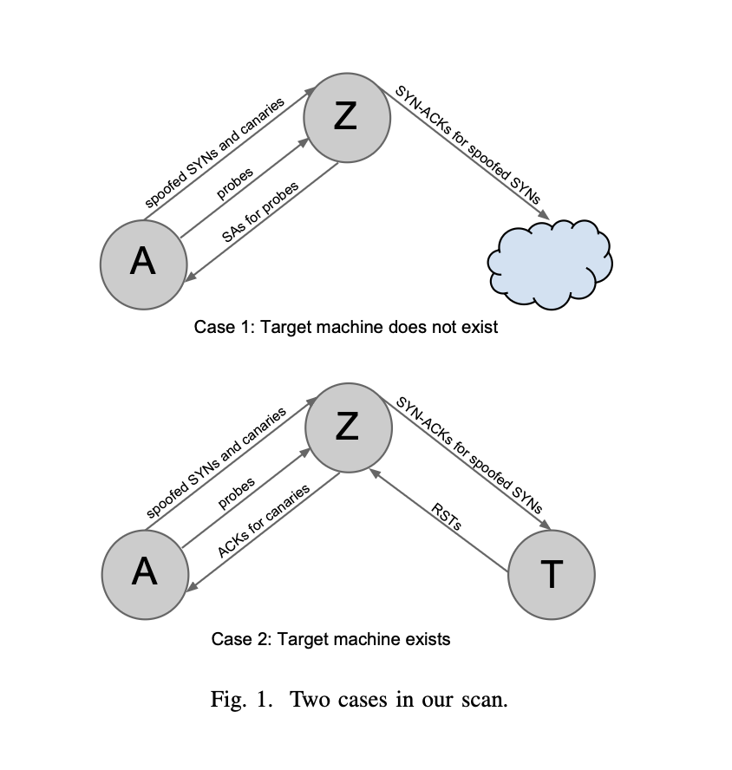
Introduction and Objective
Problem: the article “Original syn: Finding machines hidden behind firewalls.” shows how state information of an hidden system can be easily retrieve.
Attack Overview: the attack take advantages of the natural management of reachable system in order to recover state information of an unreachable target.
Thesis object: Develop a kernel patch to make more difficult for an attacker to carry out a successful attack.
Finesso Davide

Slide 4
Introduction and Objective
Problem: the article “Original syn: Finding machines hidden behind firewalls.” shows how state information of an hidden system can be easily retrieve.
Attack Overview: the attack take advantages of the natural management of reachable system in order to recover state information of an unreachable target.
Thesis object: develop a kernel patch to make more difficult for an attacker to carry out a successful attack.
Finesso Davide

Slide 5
Background, informazioni necessarie per comprendere l’attacco
Finesso Davide

Slide 6
Background | SYN
Function: Initiates a TCP connection request.
Mechanism: Sets the SYN flag in the TCP header and proposes an Initial Sequence Number (ISN).
Impact on Server: Triggers the allocation of a "half-open" connection entry in the SYN-Queue.
Security Context: Target of SYN-Flood attacks and Side-Channel analysis due to queue resource management.
Finesso Davide

Slide 7
Background | SYN-Queue
Function: Stores incoming connection requests in the SYN-RECEIVED state.
Mechanism: Buffers TCP metadata between the initial SYN and the final ACK in the Three-Way handshake.
Constraint: It has a fixed capacity, called backlog size (defined in the “listen” function); once exhausted, the server cannot accept new connections (Denial of Service).
Eviction: to prevent the easy saturation it has a mechanism that evict the oldest request faster to leave space for the newest.
Side-Channel Relevance: Variations in queue processing time and packet handling behavior can be exploited to probe server resources remotely.
Finesso Davide

Slide 8
Kernel SYN-Queue management
Kernel struct: request_sock_queue is where the SYN-Queue’s data queue resides.
Kernel paramenter: kernel variable that describe how the SYN-Queue should be managed (ie. net.core.somaxconn).
Queue relation: Accept-Queue is linked SYN-Queue, the later size is limited to the same size of the Accept_Queue.
Saturation preventing: Kernel implement some strategies to prevent the queue saturation. tcp_max_syn_backlog
Finesso Davide

Slide 9
Attacco - Dettaglio del paper e come viene portato a termine
Finesso Davide

Slide 10

Paper Attack
Attack part 1
Attack part 2
Actors: the attacker and the zombie.
Goal: the attacker trigger the eviction process of the zombie SYN-Queue in order to become aware of its real dimension. This is mandatory for the second part of the attack.
Reason: this is possible thanks to the fixed threshold of eviction defined in the kernel logic.
Actors: the attacker, the zombie and the target
Goal: the attacker take advantage of the natural eviction of the zombie SYN-Queue to retrieve information about the state of an hidden system.
Reason: this is possible thanks to the fixed threshold of eviction defined by the kernel.
Finesso Davide

Slide 11

Paper Attack | First part
Goal: the attacker trigger the eviction process of the zombie SYN-queue in order to become aware of its real dimension. This is mandatory for the second part of the attack.
Actors: the attacker and the zombie.
How: assume a backlog size, create SYN packets equal to ¾ of the assumed size to send to the zombie. After a certain period of time, check whether they are present or whether they have been expelled. If the latter is the case, the assumed backlog size was correct; otherwise, increase the size.
Reason: this is possible thanks to the fixed threshold of eviction defined by the kernel.
Finesso Davide

Slide 12
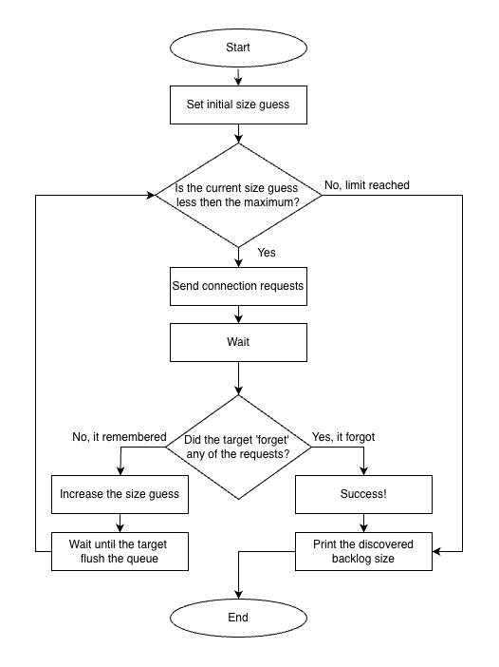
Paper Attack | First part
Assume a backlog size
Create SYN packets equal to ¾ of the assumed size
Send it to the zombie.
After a certain period of time, check whether they are present or whether they have been expelled.
If they are expired: the assumed backlog size was correct
If they are all present: increase the size and restart the process
Finesso Davide

Slide 13
Paper Attack | Second part
Goal: the attacker take advantage of the natural eviction of the zombie syn queue to retrieve information about the state of an hidden system
Actors: the attacker, the zombie and the target.
How: create SYN packets equal to ¾ of the backlog size obtained by the first part of the attack (½ spoofed and ½ legit). The attacker probes the legit one to retrieve the liveness information of the target.
Reason: this is possible thanks to the fixed threshold of eviction defined by the kernel.
Finesso Davide

Slide 14
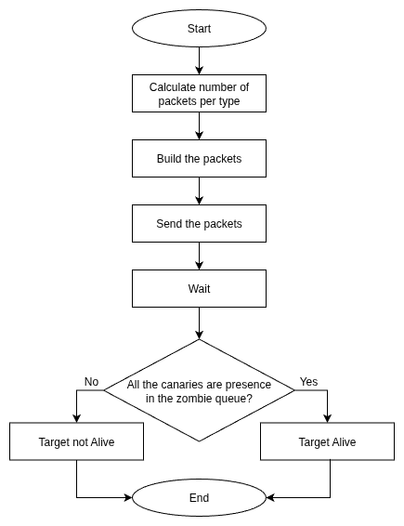
Paper Attack | Second part
Create SYN packets equal to ¾ of the backlog size obtained by the first part of the attack (½ spoofed and ½ canaries)
Shuffle the packets and send it to the zombie
After a certain period of time, the attacker probes the canaries to obtain the target state information:
If some are expired: the is not alive
If all are present: the target is alive
Finesso Davide

Slide 15
dove viene introdotto questo problema
Soglia fissa e funzioni interessate del kernel
Finesso Davide

Slide 16
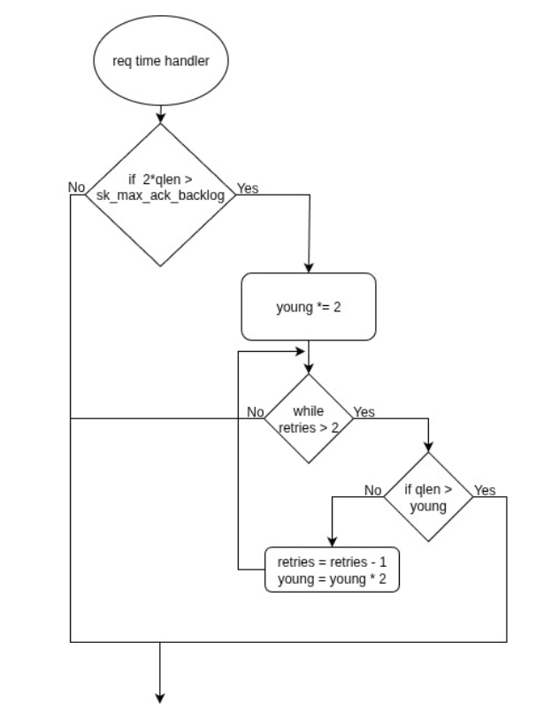
Vulnerability analysis
Kernel Code 2.12: net/ipv4/inet_connection_sock.c
if ((qlen << 1) > max(8U, READ_ONCE(sk_listener->sk_max_ack_backlog))) {
int young = reqsk_queue_len_young(queue) << 1;
while (max_syn_ack_retries > 2) {
if (qlen < young)
break;
max_syn_ack_retries--;
young <<= 1;
}
The vulnerability is not a bug but just a consequence of the natural management of the queue
Finesso Davide

Slide 17
Soluzione proposta (teorica)
Finesso Davide

Slide 18
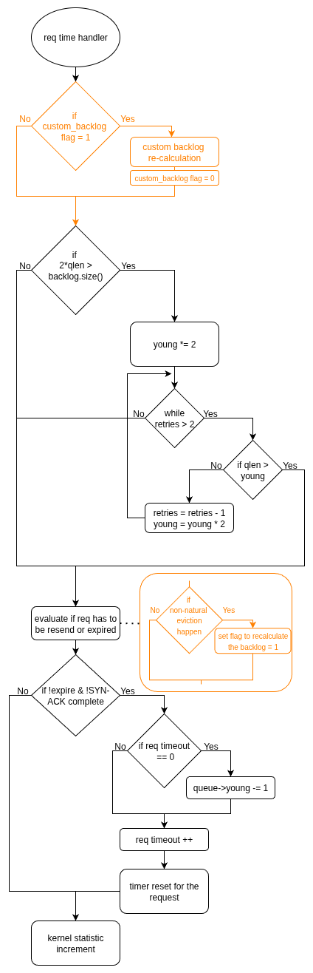
Vulnerability solution
Idea: moves from a static eviction threshold to a window randomization threshold approach.
Enforcement: refresh the threshold each time that a non-natural eviction happens.
Implementation:
custom variable added inside of the socket to manage the randomization threshold
modification of the normal workflow of the kernel eviction.
0
⅜ B
6/8 B +1
B
Finesso Davide

Slide 19
Implementazione nel kernel
Finesso Davide

Slide 20
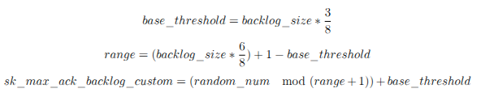
Kernel Implementation
Custom variable: fields needed to manage the custom threshold was added to the inet_connection_sock struct.
Initialization: during the socket initialization in tcp_v4_init_sock function.
Calculation: in reqsk_timer_handler function the custom threshold is update.
Update: syn_ack_recalc detect when unnatural eviction happen and save the information to recalculate the threshold.
Finesso Davide

Slide 21
Kernel Implementation
Kernel Code 4.1: include/net/inet_connection_sock.h
struct inet_connection_sock {
//Custom field
u32 sk_max_ack_backlog_custom;
int sk_max_ack_backlog_custom_updater;
spinlock_t backlog_update_lock;
unsigned long flags;
unsigned long last_token_update_jiffies;
};
Kernel Code 4.3: ipv4/inet_connection_sock.c
static void reqsk_timer_handler(struct timer_list *t){
…
if(icsk->sk_max_ack_backlog_custom_updater == 2 || (icsk->sk_max_ack_backlog_custom_updater == 1 && time_after(now, icsk->last_token_update_jiffies + TOKEN_UPDATE_INTERVAL))){
int random_backlog = calculate_backlog();
icsk->sk_max_ack_backlog_custom = (u32)random_backlog;
icsk->sk_max_ack_backlog_custom_updater = 0;
}
…
}
Kernel Code 4.5: ipv4/inet_connection_sock.c
static void syn_ack_recalc(…) {
…
if(req->num_timeout < READ_ONCE(net->ipv4.sysctl_tcp_synack_retries) && !icsk->sk_max_ack_backlog_custom_updater){
icsk->sk_max_ack_backlog_custom_updater = 1;
icsk->last_token_update_jiffies = jiffies;
}
…
}
Finesso Davide

Slide 22
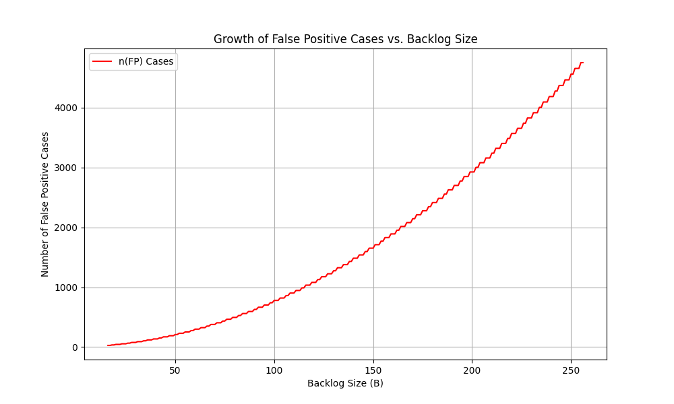
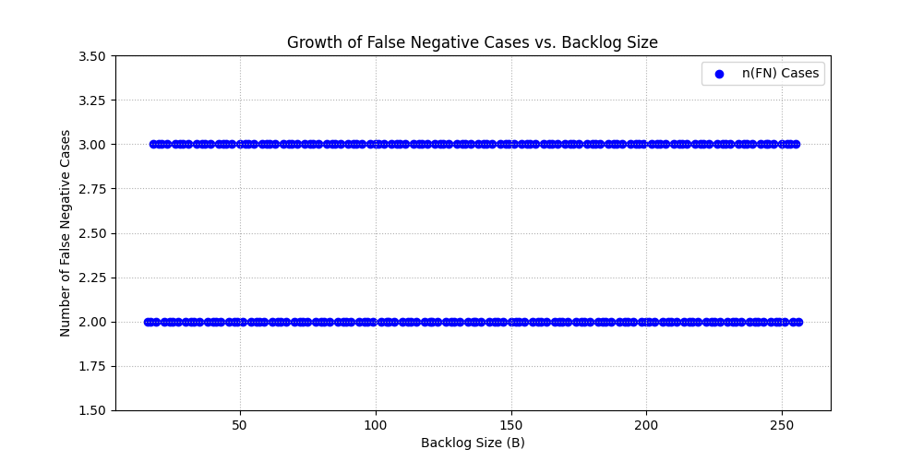
Noise definition
False Negative
False Positive
Definition: target is alive but classified as offline.
Critical condition:
Definition: target is offline but classified as alive.
Critical condition:
Finesso Davide

Slide 23
Risultati ottenuti, accenno alle performance
Finesso Davide

Slide 24
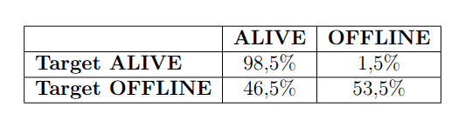
Solution results
Performance and security: the solution improves security without compromising kernel performance.
Threshold deduction: an attacker is still able to deduce the queue size and threshold value, but has no information about the next one.
Attacker error: the applied solution introduces errors when attempting to extract information about a hidden host.
For a service with 32 Backlog size:
Finesso Davide

Slide 25
Solution results
Finesso Davide

Slide 26
Conclusione e sviluppi futuri
Finesso Davide

Slide 27
Conclusion and future work
To resume: the thesis focuses on the kernel functions analyzation and provide a random eviction threshold implementation between a defined window.
Effectiveness of the solution:
Phase 1: the attacker is still able to deduce the threshold value, but cannot understand what the next one will be.
Phase 2: the statistical variance between the two states (1.5% vs. 46.4%) forces the attacker to perform massive testing, making the attack slow and easily detectable.
Future work: improve variance between two states moving to adaptive threshold windows to equalise the probabilities of error.
Finesso Davide

